Slide 1




PicPay Digital Assets
Transforming Global Payments with Circle
Solutions Engineer
Circle
solutions@circle.com
July 28, 2025

Slide 2

Agenda
1
Market Overview
5
Technical Architecture
Brazilian fintech landscape and opportunities
Integration approach and API implementation
2
PicPay's Challenges
6
Use Cases
Current pain points in global payments
Real-world applications and customer journeys
3
Circle Solutions
7
Benefits & ROI
Introduction to Circle Mint and Cross-Currency API
Business impact and competitive advantages
4
Proposed Solution
8
Implementation Roadmap
PicPay Digital Assets powered by Circle
Timeline, resources, and next steps
30-40 minute presentation

Slide 3

Why Now?
Growing Cross-Border Demand
Cross-Border Payment Pain Points
Brazilian e-commerce international purchases grew 45% in 2024, with 10M+ PicPay users making international transactions annually.
Regulatory Clarity
Law 14.478/22 established a clear framework for digital assets in Brazil, with Central Bank actively encouraging innovation in cross-border payments.
Superapp Evolution
PicPay's superapp strategy requires global payment capabilities to compete with international players entering the Brazilian market.
Strategic Partnership
Circle's partnership with Matera (June 2025) created the infrastructure for seamless BRL-USDC integration in Brazilian financial institutions.

Slide 4

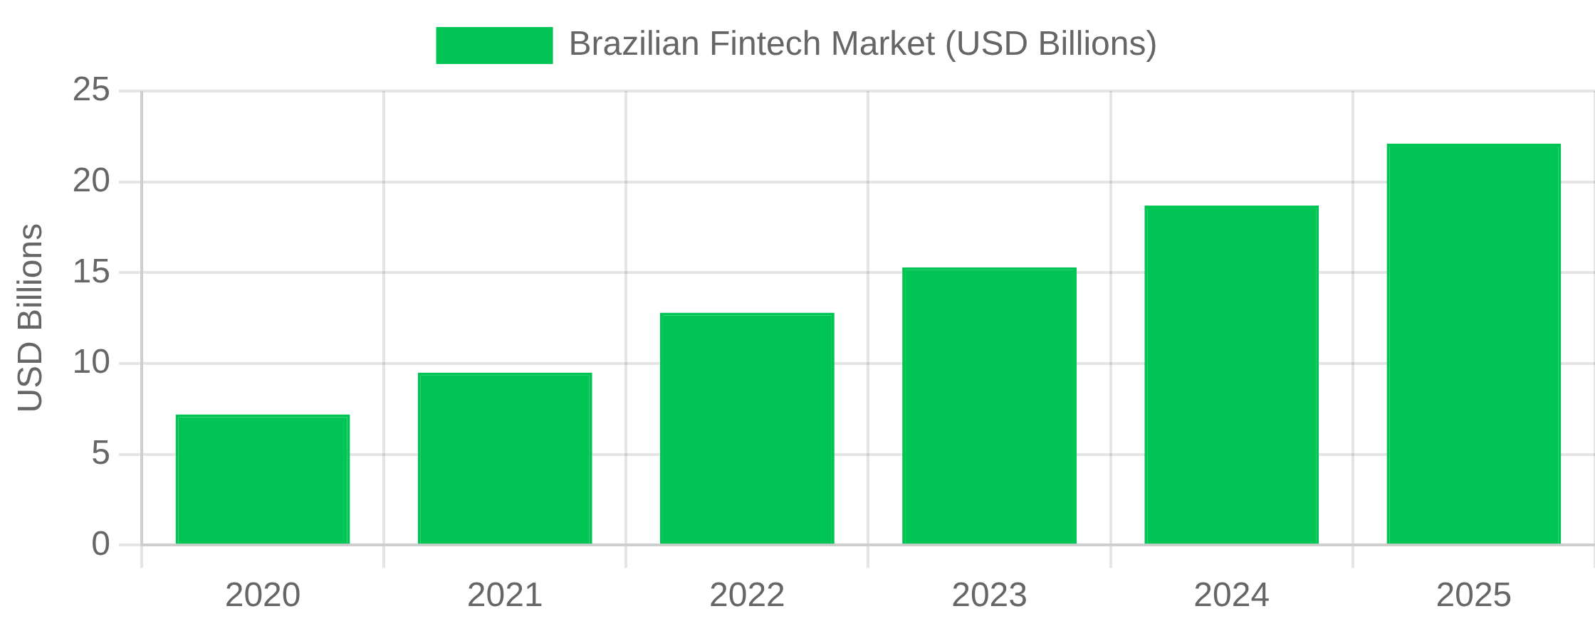
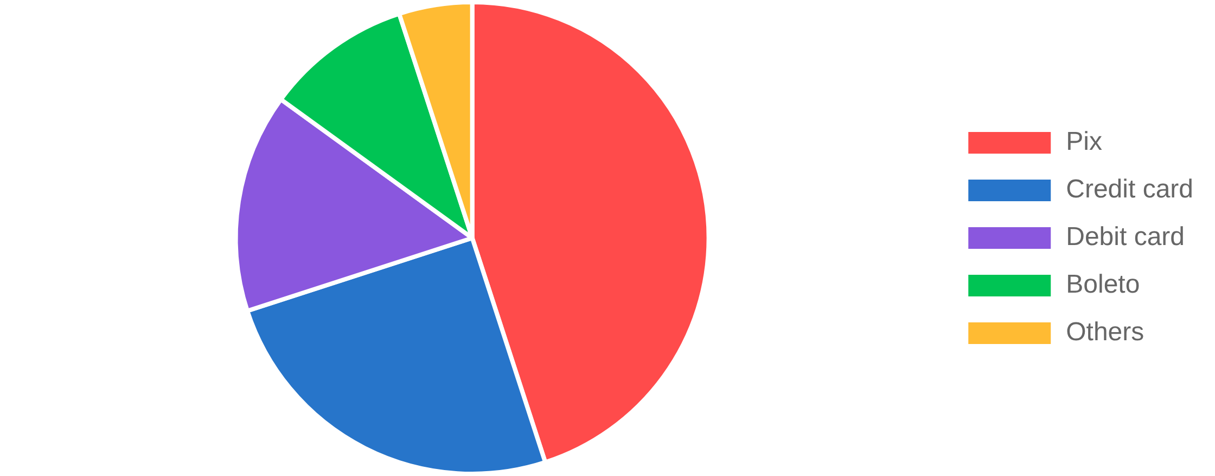

Brazilian Market Overview
PicPay in Numbers
Fintech Market Growth
58 million
3rd
active accounts
largest neobank
Source: IMARC Group, 2025
Payment Methods in Brazil
Market Positioning
Nubank
75 million
Inter
60 million
PicPay
58 million
Only one with superapp positioning
Source: Central Bank of Brazil, 2024

Slide 5
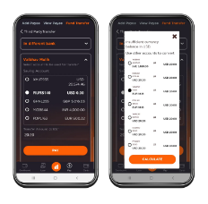
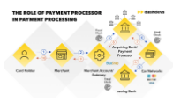
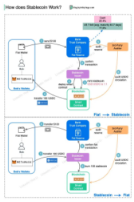
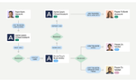
PicPay's Current Challenges
High International Fees
Slow Processing Times
PicPay users pay 4-6% in fees for international transactions through traditional banking partners, plus hidden FX spreads of 2-3%.
International transfers take 2-3 business days to complete, causing frustration for users sending money to family abroad or making time-sensitive payments.
Impact: R$120M in excessive fees paid by users annually
Impact: 65% of users report dissatisfaction with transfer speed
Limited Global Reach
Competitive Pressure
Current infrastructure only supports 12 countries directly. Users must leave the PicPay ecosystem to make payments to merchants or individuals in unsupported regions.
Global fintechs like Wise and Revolut are entering Brazil with native multi-currency solutions. Nubank and Inter are developing similar offerings, threatening PicPay's superapp strategy.
Impact: 40% of international payment attempts fail or require redirection
Impact: Potential loss of 15% of high-value users within 12 months

Slide 6



Circle: Global Financial Infrastructure
Key Products for PicPay
Circle Mint
Enterprise-grade solution for minting and redeeming USDC stablecoins, enabling seamless conversion between fiat and digital currencies.
1:1 USD backing
Regulated
Multi-chain
API-first
Circle is a global financial technology firm that enables businesses to harness the power of digital currencies and public blockchains for payments, commerce and financial applications worldwide.
Cross-Currency API
Enables instant, low-cost currency conversions and transfers across borders using USDC as a bridge currency.
$50B+
180+
180+ countries
Near-instant settlement
Low fees
Programmable
USDC in circulation
Countries supported
10M+
1,000+
Payments API
Monthly transactions
Enterprise customers
Accept and make payments globally using traditional and digital currencies with unified settlement.
Trusted By
Card processing
Crypto payments
Merchant tools
Fraud protection

Slide 7






PicPay Digital Assets Solution
Seamless integration of USDC into PicPay's superapp ecosystem
USDC → BRL (redeem)
PicPay
Circle
BRL → USDC (mint)
PicPay Users
Merchants
Global Network
Financial System
Native USDC Wallet
Instant Conversion
Global Transfers
International Payments
Fully integrated USDC wallet within PicPay app, allowing users to hold, send, and receive USDC alongside BRL balances.
One-click conversion between BRL and USDC with competitive rates and minimal fees using Circle Mint API.
Send money internationally in minutes instead of days, with up to 50% lower fees than traditional methods.
Pay international merchants directly with USDC or instantly convert to local currency at point of sale.

Slide 8
Technical Architecture
PicPay Mobile App Layer
Implementation Steps
USDC Wallet UI
Conversion UI
Transfer UI
1
Set up Circle Business Account and obtain API keys
PicPay Backend Layer
2
Implement USDC wallet service in PicPay backend
User Service
USDC Service
Payment Service
3
Integrate Circle Mint API for BRL ↔ USDC conversion
4
Implement Cross-Currency API for international transfers
Circle API Layer
Circle Mint API
Cross-Currency API
5
Develop UI components for wallet and transfers
Blockchain Layer
6
Set up monitoring and compliance systems
Ethereum
Polygon
* All communication secured with TLS 1.3 and API key authentication
Circle Mint API Integration Example
Recommended Tech Stack
// Example: Converting BRL to USDC
Backend: Node.js / Java
async
function
mintUSDC
(userId, brlAmount) {
For API integration and business logic
// 1. Convert BRL to USD using current exchange rate
Database: PostgreSQL
const
usdAmount
=
await
convertBRLtoUSD
(brlAmount);
For transaction records and user balances
// 2. Call Circle Mint API
Security: HSM / KMS
const
response
=
await
fetch
(
'https://api.circle.com/v1/businessAccount/transfers'
, {
For secure key management
method
:
'POST'
,
headers
: {
'Authorization'
:
`Bearer ${apiKey}`
,
'Content-Type'
:
'application/json'
},
body
:
JSON.stringify
({
idempotencyKey
:
generateUUID
(),
source
: {
type
:
"wallet"
,
id
:
"picpay-usd-wallet"
},
destination
: {
type
:
"blockchain"
,
chain
:
"ETH"
},
amount
: {
amount
:
usdAmount
.toString(),
currency
:
"USD"
}
})
});
return
await
response
.
json
();
}

Slide 9


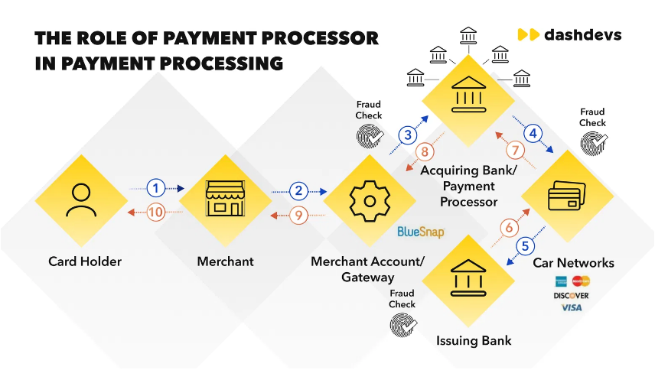
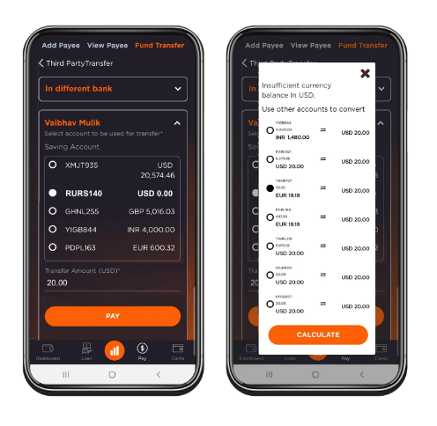


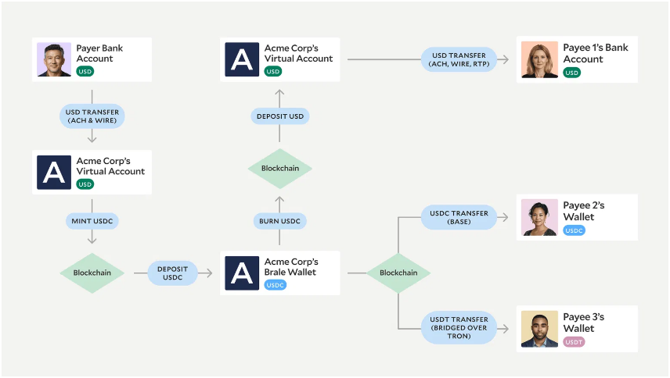
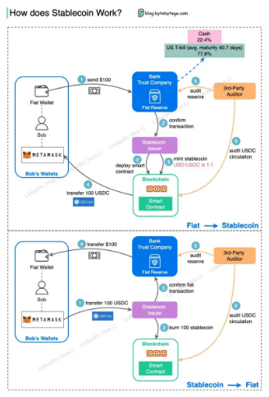
Use Cases
Instant Remittances
Multi-Currency Wallet
Problem:
Transfers take up to 2 business days
Problem:
Debit card doesn't work abroad
Solution:
BRL → USDC → instant transfer
Solution:
BRL, USD, USDC balances in same
Benefit:
Minutes instead of days
wallet
Benefit:
Unified global experience
International E-commerce
Digital Dollar Savings
Problem:
High spread on credit cards
Problem:
Difficult USD exposure for individuals
Solution:
Direct payments in USDC
Solution:
BRL → USDC as "dollar savings"
Benefit:
Lower fees, USDC cashback
Benefit:
Currency hedge with full liquidity

Slide 10

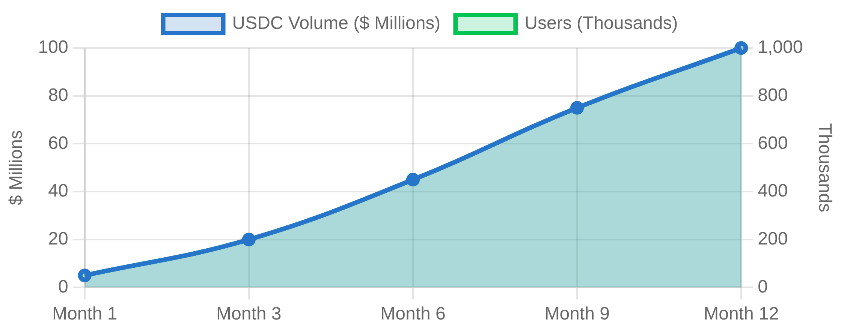




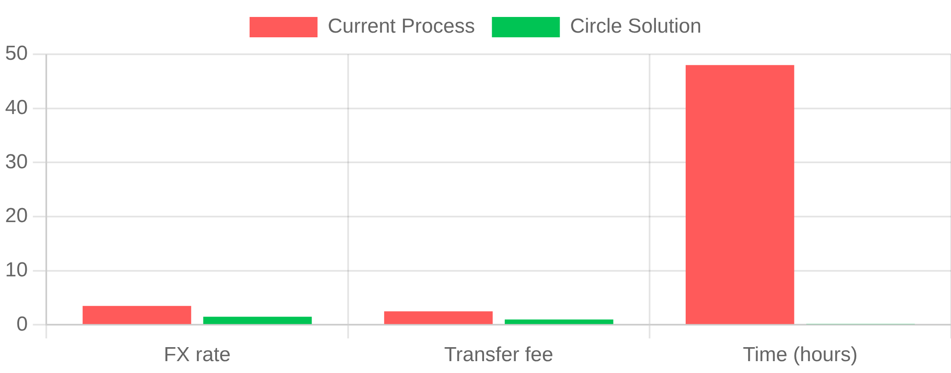
Benefits and ROI
Benefits for PicPay
Impact Projections
Competitive differentiation
- First superapp with native USDC
New revenue stream
- FX spreads without intermediaries
User retention
- Lower churn with USDC balances
International expansion
- Infrastructure for global operations
$100M USDC
in year 1
1M active users
50% reduction
in costs
NPS improvement
Benefits for Users
Speed
- International transfers in minutes
Cost Comparison
Lower costs
- Up to 50% reduction in fees
Convenience
- Everything in one app, no redirects
Global access
- Simplified international payments
Current process vs. Circle Solution

Slide 11






Implementation Roadmap
1
Phase 1: MVP
Regulatory Considerations
First 3 months
Law 14.478/22
- Legal framework for virtual
Circle Mint API integration for USDC mint/redeem
assets in Brazil
Basic interface in PicPay app for BRL ↔ USDC conversion
Central Bank
- VASP (Virtual Asset Service
Provider) authorization
USDC wallet implementation and custody infrastructure
Compliance
- AML/KYC already implemented
Initial compliance and regulatory alignment
in PicPay
Circle Support
- Dedicated regulatory team
for assistance
2
Phase 2: Payments
4-6 months
Next Steps
USDC P2P transfers within and outside PicPay
International merchant payments
1
MOU (Memorandum of Understanding) signing
International card with USDC balance
2
Access to Circle sandbox environment
USDC cashback program
3
Dedicated technical team definition
4
Detailed technical workshop with Circle team
3
Phase 3: Expansion
5
Detailed implementation timeline
7-9 months
Integration with more blockchains (Solana, Avalanche)
EURC support for European market
APIs for partners and developers
Advanced financial products based on USDC

Slide 12






Let's transform global payments together?
Join Circle and PicPay to create the first Brazilian superapp with native digital assets, offering a unified global experience for 58 million users.
Next Steps
1
2
3
4
MOU Signing
Sandbox access
Technical team definition
Implementation timeline
solutions@circle.com
+1 (888) 908-7930
Schedule a technical session

